Slide 1
SPINAL CORD INJURY
Channing Callahan
Crystal Buck
Jen Vogl

Slide 2
Pathophysiology:
Injury ranges from: transient concussion, contusion, laceration, compression, or severing of the spinal cord.
SCI’s can also be separated into 2 categories:
-Primary Injury-result of the initial insult or trauma and is usually permanent.
-Secondary Injury-are usually a result of a contusion or tear injury in which the nerve fibers begin to swell and disintegrate.
Secondary injury can also be a result of hypoxia, hemorrhage that destroys the nerve tissues, and they can be reversible in the first 4-6 hours following injury.

Slide 3
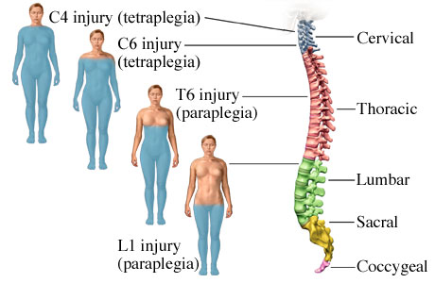

Slide 4
Most Common Causes:
Motor Vehicle Accident (MVA)
Falls –compression of the spinal cord
Violence-gunshot wounds
Sports
Can lead to paraplegia or quadraplegia (also called tetraplegia)

Slide 5
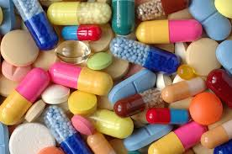
Risk Factors:
Young age
Male gender
Alcohol use
Drug use

Slide 6
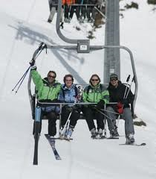
Case Study:
22 year old man who fell 50 feet from a chair lift and landed on hard packed snow. He is now in the ED with a suspected T5-T6 fracture with paraplegia.
Physician Orders:
ECG Monitoring
4L O2 nasal cannula
Neurologic assessment every hour
Warming blankets as needed

Slide 7
What types of things would we want to assess on this patient?

Slide 8
Assessment:
Neuro: sensation, LOC, moving extremities, pupil reaction to light, oriented x3, spinal shock
Pulmonary: lung sounds, breathing pattern, cough, Respiratory Rate, ventilator.
Cardiovascular: Heart sounds, capillary refill, BP, edema.
Pain level
Skin: temperature
Assess for other injuries (head/chest)
Urinary: will probably be incontinent and have a foley placed

Slide 9
Possible Nursing Diagnosis’:
Ineffective Breathing Pattern
Ineffective Airway Clearance
Impaired bed and physical mobility
Disturbed sensory perception
Risk for impaired skin integrity
Impaired urinary elimination
Constipation
Acute pain
Sensory impairment

Slide 10
Nursing Diagnosis #1
Ineffective breathing patterns RT- weakness or paralysis of abdominal and intercostal muscles and inability to clear secretions. AEB-low O2 sats, patient is SOB.
Goal: to maintain a normal respiratory rate, keep O2 sats above 90%, decrease SOB.
Interventions: put patient on oxygen, maintain patent ventilation

Slide 11
Nursing Diagnosis #2:
Impaired skin integrity RT-bedrest and lack of movement because of SCI AEB-reddening of boney prominent areas, skin tears, bed sores.
Goal: maintain good skin integrity, keep blood perfusing to all areas.
Interventions: turn patient Q2 hours, use turn system, keep peri area clean and dry.

Slide 12
Nursing Diagnosis #3
Sensory impairment RT-SCI AEB-patient has no feeling below area of injury
Goal: patient will be able to maintain current sensory areas above SCI site, prevent bodily contractures.
Interventions: maintain body in proper alignment, do ROM exercises.

Slide 13
Diagnostic Tests:
X- Rays (lateral cervical spine)
CT scan
MRI may be ordered if ligamentous injury is suspected.
Myelogram
Neurologic exams to assess motor and sensory function from baseline

Slide 14
What are some possible labs that the doctor will order?

Slide 15
Labs:
CSF- cerebral spinal fluid
CBC
PT/PTT
Various organ function tests
BMP

Slide 16
Medications:
IV corticosteriods
Methylprednisolone sodium succinate
Some sort of anticoagulation drug to prevent DVT/PE (Heparin, Coumadin)
Pain medication-Morphine, Dilaudid
Vasopressors-to help with BP and Orthostatic Hypotension
Antispasmotics
PPI to reduce change of stomach stress ulcers
Stool softener/laxative
Anti embolism stockings
Pneumatic compression devices

Slide 17
Complications of SCI:
Spinal Shock: sudden depression of reflexes below the spinal cord injury. (flaccid muscles and lack of sensation and reflexes)
Neurogenic Shock: loss of function of the ANS (decreased BP, HR, CO, venous pooling in periphery)
Autonomic Dysreflexia: occurs after spinal shock has resolved and can occur several years later. (severe headache, sudden increase in BP, profuse diaphoresis, nausea, bradycardia)
Triggering stimuli could include: distended bladder, constipation, or stimulation of the skin.

Slide 18
Case Study Continued:
The physcian orders the following for T.W.
IV Methyprednnisolone (Solu-Medrol)
Bolus of 30mg/kg over 15 minutes
Maintenance infusion of 5.4 mg/kg per hour
The diagnosis of the fracture is confirmed and T.W. is transferred to the ICU. Although his injury is at a level where independent respiratory function is expected, he experiences low O2 levels and is ventilated. The physician states that this is due to Spinal Shock.

Slide 19
How would you teach T. W.’s family about Spinal Shock and why he is on a ventilator?

Slide 20
Spinal Shock Teaching:
Spinal shock is a sudden depression of reflexes below the spinal cord injury. This happens because the spinal cord below the level if injury is damaged and neurologic messages cannot be transmitted down the spinal cord.
T.W.’s lower half cannot receive messages from the brain to move his extremities.
This causes the flaccid muscles, lack of sensation and reflexes.
He is on a ventilator because his body functions are compromised because of the nerve damage. His ability to breath is impaired and we want to decrease the amount of energy his body is expending.

Slide 21
Case Study:
T. W. is taken to surgery 48 hours after the accident, for spinal stabilization. He spent 2 additional days in the ICU and 5 days in the neuro unit and is now being transferred to you. He continues to have no movement in his lower extremities.

Slide 22
Rehabilitation Teaching includes teaching T.W. how to manage his urinary drainage system. What would this teaching include?

Slide 23
Foley Teaching:
Catheter care
Increased risk for UTI
Frequent peri care
Keep drainage bag below level of the bladder
Make sure tubing isn’t kinked and it is draining properly

Slide 24
Patient Teaching for SCI:
Will need long term rehab and physical therapy
Will have to have help most likely with ADL’s
Teaching regarding injury and how to cope with it
Will need a home health nurse to help with all the demanding tasks
Long road to recovery
Patient may never regain baseline function of body below injury
Females can still get pregnant and it is rarely contraindicated because sexual organs are unharmed
Minimize smoking and alcohol use
Teach about healthy lifestyles and activity they can engage in
Need health screenings

Slide 25
Case Study Continued:
T.W. turns on his call light and asks for medication for his headache. You notice that his face is flushed and expect that he may be experiencing Autonomic Dysreflexia.
1. What further assessment do you need to collect?
2. What is Autonomic Dysreflexia and what are its causes?
3. What interventions do you need to perform for a patient with AD?

Slide 26
Answers:
1. check BP, note severity of headache, assess for sweating and nausea. Check HR and watch for bradycardia.
2. Medical Emergency that causes dangerously high BP. Triggering stimuli could include: distended bladder, constipation, or stimulation of the skin
3. Put T.W. on a Tele/heart monitor, immediately try to relieve stimulating cause (have them go to the bathroom, etc.) Check blood pressure. Notify physician.

